Slide 1
3D Path Planning: Pruning with Constraint Satisfaction (7a)
-

Slide 2
Introduction:-
Three-dimensional (3D) path planning is widely applicable in domains such as aerospace, oceanography, agriculture, and the military for many tasks, including but not limited to searching regions, space coverage, or reaching targets. With the proliferation of drones and UAVs (Unmanned Aerial Vehicle) that need to able to plan a feasible path in three dimensions, the applications of 3D path planning have become even more significant. In general, given the start and target locations, the goal of path planning is defined as planning a collision-free path from 3D obstacles while satisfying certain criteria, such as distance, smoothness, or safety. As mobile robot path planning is considered to be NP-hard, 3D path planning is also NP-hard with an additional axis for height [5], [22], [25]. In previous decades, several methods to overcome the complexity of this problem have been developed. The classical approaches include A*, Dijkstra, PRM (Probabilistic Roadmap Method), and Artificial Potential Field. These approaches were intensively studied in the early days of 3D path planning. More recently, path planning in three dimensions has been studied with heuristic approaches, such as soft computing, meta-heuristics, and hybridized heuristics with classical methods.

Slide 3
Improvements:-

Slide 4
Importance of RRT*SplineFitting_NodePurning_2phaseSampling algorithm:-
Before understanding the importance of the alogirthm, let’s get into details of what are not possible without this:
No nodes are formed
No neural networks are formed
No actual or shortest path are formed and arc isn’t formed.
Importance of RRT*SplineFitting_NodePurning_2phaseSampling algorithm:
The algorithm helps to find actual path along with its arc and helps us understand the projection.
Over and above this, the advantage it carries is to find shortest path between two nodes among all the plaussible neural networks. The same is color coded so that the graphical user interface speaks for itself to the end users using the algorithm.

Slide 5
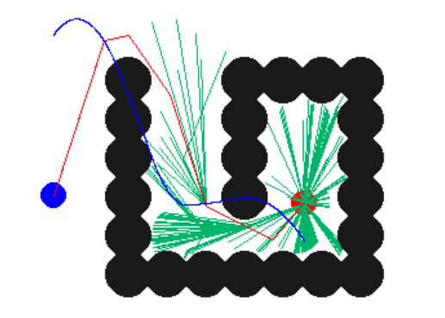
RRT*SplineFitting_NodePurning_2phaseSampling
Challenge that was considered:
Finding out midpoint between two points from source to destination everytime.
Solution:
In order to bring efficiency, I have considered to use sorting mechanism (ascending) by using x.sort() and y.sort() functions.
These functions are used to select initial point. It leads us to get all nodes check its path and give us the shortest possible path between the initial and final points there by improving efficiency of the system.

Slide 6
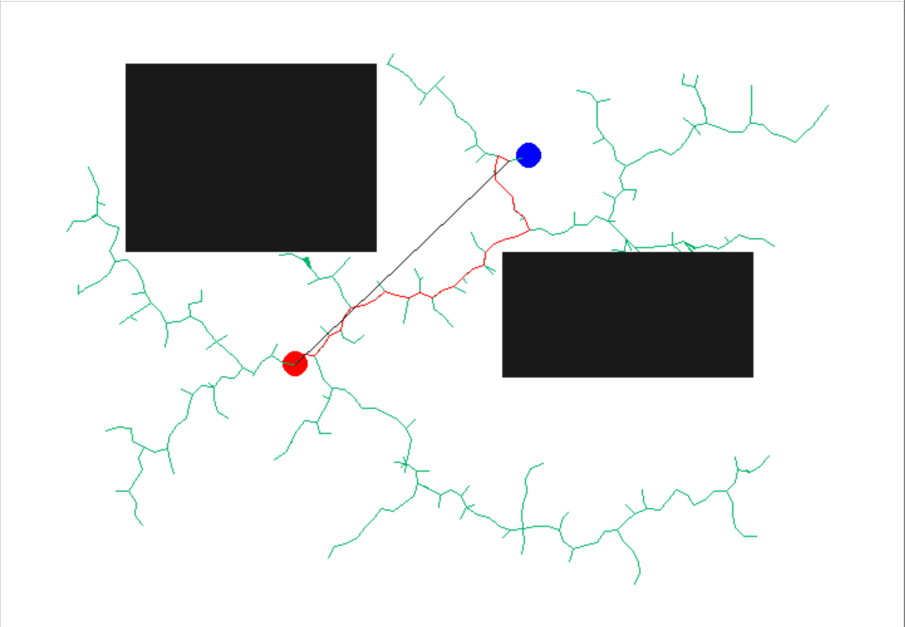
RRT_NodePurning:
Challenge that was considered:
When initial final points are changed, the actual path isn’t getting updated. This may be leading to inefficiencies.
Solution:
We have updated system such that the actual path is updated per every change in intial and final points. In addition to this, we added shortest path.

Slide 7
Importance of :- RRT_NodePurning
Understanding the current usage, for instance,in map based applications it becomes vital to establish shortest path between two coordinates in accordance with various permutations and combinations of environment by understanding live feed of traffic, jams, one-ways etc.
Importance of RRT_NodePurning algorithm:
The algorithm helps us to find shortest distance between two points in a 2 dimensional system. The same is represented in the graphical user interface, where black line between points depcits shortest path and red color represents actual path on a network.

